Slide 1
CPE 404
Computer Hardware Design
Dr Osama Hosameldeen
Spring 2021
Lecture 11
Sequencing and Control – Part I

Slide 2
Topics
The Control Unit
Algorithmic State Machines (ASM)
ASM Elements
Hardwired Control
  One Flip-Flop Per State
  Sequence Register and Decoder
VHDL Representation
Notes:
School of Engineering

Slide 3
CPU: Control Units

Slide 4
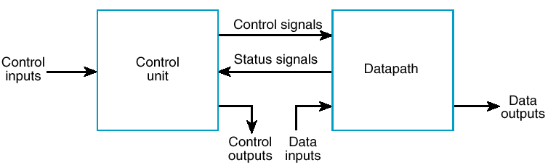
Parts of CPU
Datapath Unit consists of:
  Registers, Multiplexors, Adders, Subtractors, ALUs and logic to perform operations on data (Comb Logic)
Control Unit is responsible for:
  Generates signals to control data-path and others
  Accepts status signals to perform sequencing
Control
Data Path
Switches

Slide 5
The Control Unit
The binary information stored in a digital computer can be classified as either data or control information.
  Data is manipulated in a data-path
    To perform arithmetic, logic, shifting, and other data-processing tasks.
    These operations are implemented within the ALUs with the support of registers, multiplexers, and busses.
  The control unit
    Provides signals that activate the various micro-operations in the data-path to perform the specified data processing tasks.
    The control unit also determines the sequence in which the various actions are performed (i.e. when they are to be performed)

Slide 6
Control Unit Types
Two distinct classes:
  Programmable
  Non-programmable.
A programmable control unit has:
  An external ROM or RAM array for storing instructions (micro operations) and control information
  A program counter (PC) or other sequencing register with contents that points to the next instruction to be executed
  Decision logic for determining the sequence of operations and logic to interpret the instructions
A non-programmable control unit (Hardwired Control) does not fetch instructions from a memory but → just determines the operations to be performed and the sequence of those operations based only on inputs and status bits.
We will only cover non-programmable control unit

Slide 7
Algorithmic State Machines

Slide 8
Algorithmic State Machines (ASM)
The function of a state machine (or sequential circuit) can be represented by a state table or a state diagram.
What is wrong with state diagrams?
  Gets messy as states grow
  Decisions to move to different states are not clearly obvious.
Solution?
A flowchart is a way of showing actions and control flow in an algorithm.
  An Algorithmic State Machine (ASM) is simply a flowchart-like way to specify state diagrams for sequential logic and, optionally, actions performed in a datapath.
  While flowcharts typically do not specify “time”, an ASM explicitly specifies a sequence of actions and their timing relationships.

Slide 9
ASM Primitives
State Box
(a rectangle)
Scalar Decision Box
(a diamond)
Vector Decision Box
(a hexagon)
Conditional Output Box (oval).
The State Box is a rectangle, marked with the symbolic state name, containing register transfers and output signals activated when the control unit is in the state (actions).
The Scalar Decision Box is a diamond that describes the effects of a specific input condition on the control. It has one input path and two exit paths, one for TRUE (1) and one for FALSE (0).
The Vector Decision Box is a hexagon that describes the effects of a specific n-bit (n > 2) vector of input conditions on the control. It has one input path and up to 2^{n} exit paths, each corresponding to a binary vector value.
The Conditional Output Box is an oval with entry from a decision block and outputs activated for the decision conditions being satisfied.
(Input)
START
00
Z, Q0
10
01
From Decision Box(es)
(Register transfers
R ← 0

Slide 10
State Box
A rectangle with:
  The symbolic name for the state marked outside the upper left top
  Containing register transfer operations and outputs activated within or while leaving the state
  An optional state code, if assigned, outside the upper right top
  For example, if we have 4 states then (00,01,10,11)
(Symbolic Name)
(Optional state code)
IDLE
0000
(Register transfers
or outputs)
R ← 0
RUN

Slide 11
Scalar Decision Box
A diamond with:
  One input path
  (entry point).
  One input condition, placed in the center of the box, that is tested.
  It has two exit points:
    A TRUE exit path taken if the condition is true
    (logic 1).
    A FALSE exit path taken if the condition is false
    (logic 0).
(False Condition)
(True Condition)
0
(Input)
1
START

Slide 12
Vector Decision Box
(Binary Vector Values)
(Binary Vector Values)
A hexagon with:
  One input path (entry point).
  A vector of input
  conditions, placed in the
  center of the box, that is
  tested.
  Up to 2^{n} output paths. The path taken has a binary vector value that matches the vector input condition
00
(Vector of Input
Conditions)
10
01
Z, Q0
11

Slide 13
Conditional Output Box
An oval with:
  One input path from a decision box or decision boxes.
  One output path
  Register transfers or outputs that occur only if the conditional path to the box is taken.
Transfers and outputs in a state box are Moore type - dependent only on state
Transfers and outputs in a conditional output box are Mealy type - dependent on both state and inputs
From Decision Box(es)
(Register transfers
or outputs)
R ← 0
RUN

Slide 14
Connecting Boxes Together
By connecting boxes together, we begin to see the power of expression.
What are the:
  States?
  Inputs?
  Outputs?
  Conditional Outputs?
  Transfers?
  Conditional Transfers?
IDLE
R← 0
AVAIL= 1
0
1
States: → IDLE
Inputs: → Start
Outputs: → Reset R, set Avail=1
Conditional Outputs/Transfers:
  → PC =0
  → INIT
START
PC ← 0
INIT

Slide 15
ASM Blocks
One state box along with all decision and conditional output
boxes connected to it is called an ASM Block.
  The ASM Block includes all items on the path from the current state to the same or other states.
Entry
IDLE
ASM BLOCK
AVAIL
START
R← R + 1
R ← 0
Exit
0
1
Q0
Exit
Exit
MUL0
MUL1

Slide 16
State Diagram → ASM

Slide 17
From State Diagram to ASM
Inputs?
S = 0
Z = 1
A
B
C
S = 1
Z = 0
We move from state B to state C unconditionally

Slide 18
From State Diagram to ASM
S = 0
Z = 1
A
B
C
S = 1
Z = 0
A
00
0
1
S
B
01
C
10
0
1
Z

Slide 19
Example (1)
Find the ASM chart corresponding to the following description
  There are two states A, B
  If in state A and input X is `0’ then the next state is A
  If in state A and input X is `1’ then the next state is B
  If in state B and input Y is `1’ then the next state is B
  If in state B and input Y is `0’ then the next state is A
  Output Z is equal to `1’ while the circuit is in state B
Solution:
Total States → 2
Two Inputs → X, Y
One Output → Z

Slide 20
ASM for Example (1)
A
0
1
X
B
Z = 1
1
0
Y

Slide 21
Example (2)
Find the Data Path and ASM for the following problem:
  We first need to load two registers (R1, R2) with some value.
  We will then need to add the two Registers (R1, R2) and save the result in Register R3.
  All these operations should occur if a “start” Signal is activated.
Translation to Hardware:
  We need to clear the registers first.
  If the “start” signal is set to 0, I do nothing
  Else If “start” signal is set to 1, load-1 R1, R2 with values
  Next, enable R3 to be loaded (load-2) by the results of R1+R2
Inputs/Outputs:
  start is an input signal (Use a switch)
  clear is an output signal generated and connected to R1, R2, R3
  load-1 is an output signal generated and connected to R1, R2
  load-2 is an output signal generated and connected to R3

Slide 22
Data Path?
Switches
Switches
clear
clear
Register R1
Register R2
load-1
load-1
Adder
Signals generated by Control Unit: Implemented via ASM
clear
Register R3
load-2
  We need to clear the registers first.
  If the “start” signal is set to 0, then do nothing
  Else If the “start” signal is set to 1, load-1 R1, R2 with values
  Next, enable R3 to be loaded (load-2) by the results of R1+R2

Slide 23
ASM Example 2
Clear Registers
A
R1← 0
R2← 0
R3← 0
00
0
1
S
Load Registers: R1, R2
B
R1← Val1
R2← Val2
01
Load Registers: R3
10
C
R3← R1+R2

Slide 24
Continue … ASM Example 2
A
CLR
00
0
1
S
B
LD1
01
C
LD2
10

Slide 25
Hardwired Control

Slide 26
Hardwired Control
Designing the Control Unit:
  One Flip-flop per State A flip-flop is assigned to each of the states and at any time, only one of the flip flops contains a 1, with all the rest containing 0.
  Sequence Register and Decoder Uses a sequence register for the control states and a decoder to provide an output signal corresponding to each of the states.

Slide 27
One Flip Flop per State

Slide 28
I. One Flip-Flop per State
As the name implies the method uses one flip-flop per state and a simple set of transformation rules to implement the circuit.
The design starts with the ASM chart,
Then all you do is replace:
  A State Box with a D flip-flop,
  A Scalar Decision Box with a demultiplexer with 2 outputs,
  A Vector Decision Box with a (partial) demultiplexer
  Any Junction with an OR gate, and
  Any Conditional Output with an AND gate
    (for a Mealy Machine!!)

Slide 29
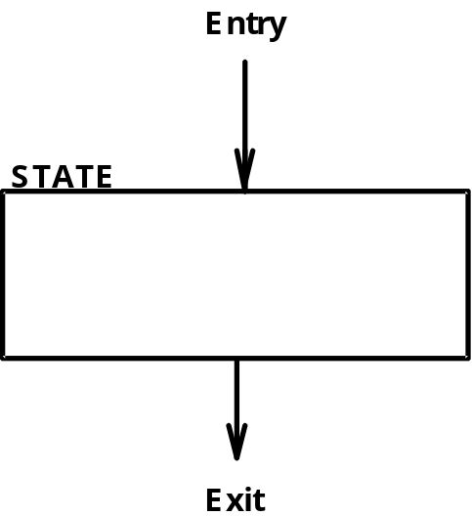
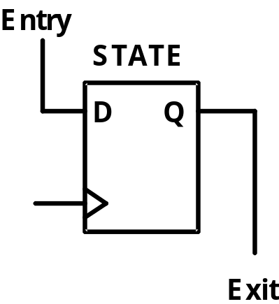
State Box Transformation
Rules
Each state box transforms to a D Flip-Flop
  Entry point is connected to D FF input.
  Exit point is connected to the D FF `Q’ output.

Slide 30
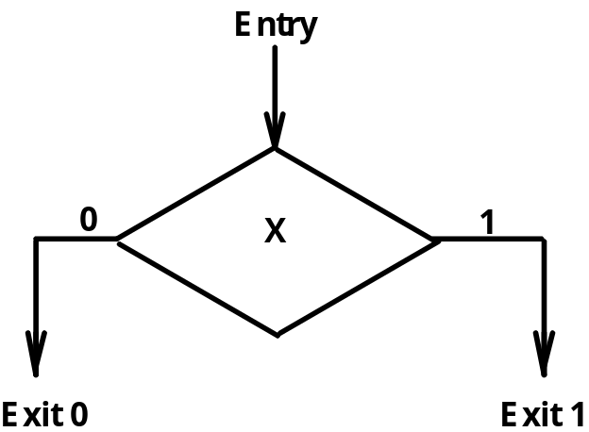
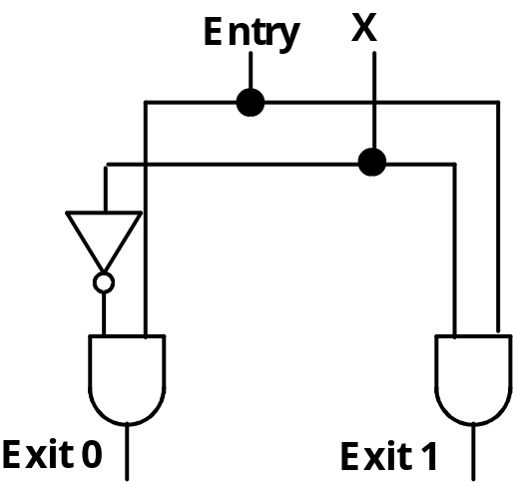
Scalar Decision Box
Transformation Rules
Each Decision box transforms to a Demultiplexer
  Entry points are "Enable" inputs.
  The condition is the "Select" input.
  Decoded Outputs are the Exit points.

Slide 31
Scalar Decision Box
Transformation Rules
Each Decision box transforms to a Demultiplexer
  Entry points are "Enable" inputs.
  The Condition is the "Select" input.
  Decoded Outputs are the Exit points.
X
Entry
DeMux
Exit 0
Exit 1

Slide 32
Vector Decision Box
Transformation Rules
Each vector decision box transforms to a Demultiplexer
  Entry point is Enable inputs.
  The Conditions are the Select inputs.
  Demultiplexer Outputs are the Exit points.
Entry
(Binary Vector Values)
(Binary Vector Values)
DEMUX
(Vector of Input
Conditions)
Entry
EN
D₀
Exit 0
00
10
X₁
A₁
D₁
Exit 1
01
X₁, X₀
X₀
A₀
D₂
Exit2
D₃
Exit 3

Slide 33
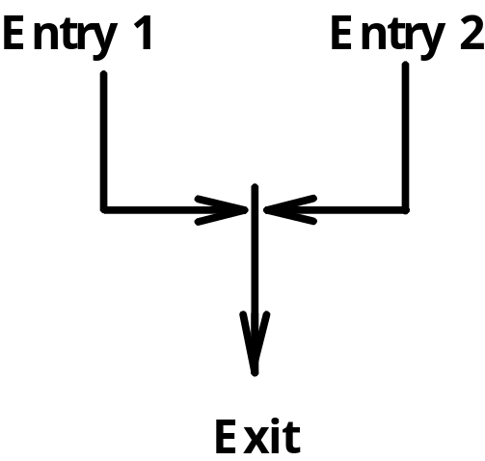
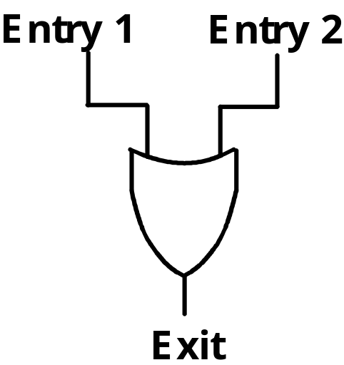
Junction Transformation Rules
Where two or more entry points join, connect the entry variables to an OR gate
  The Exit is the output of the OR gate

Slide 34
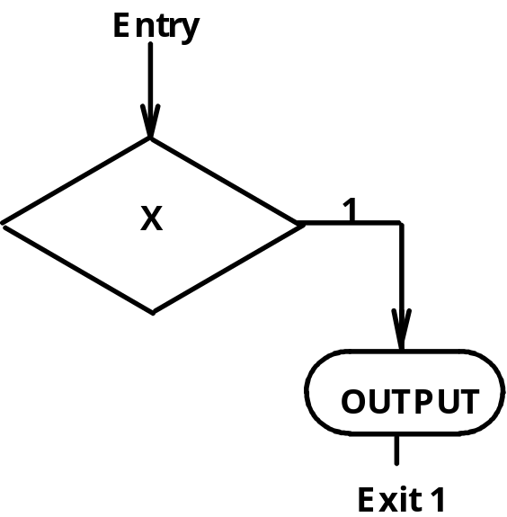
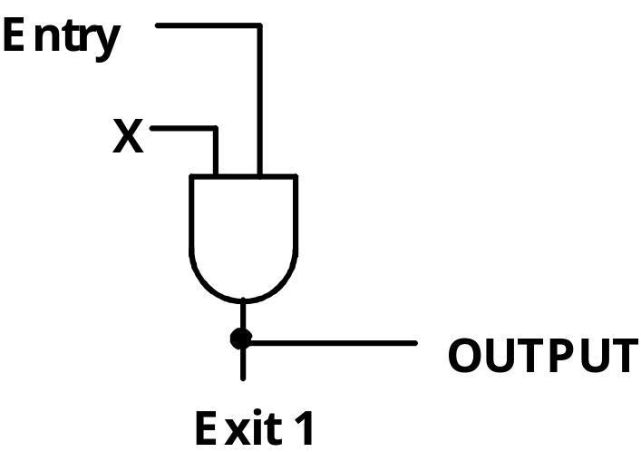
Conditional Output Box Rules
If each branch takes you to a different state or direction then use a Demux with two outputs.
  Entry point is Enable input.
  The Condition is the "Select" input.
  Demux Outputs are the Exit points.
  The Control OUTPUT is the same signal as the exit value.
If both branches take you to the same state then use a single AND gate instead of a Demux. The FF output will be directly connected to the next FF.

Slide 35
Implement using 1 Flip Flop
Per State
3 Control Signals need to be generated
(1) One FF is assigned to each of the states, and at any time, only one of the FFs outputs a 1, with all the rest containing 0.
(2) When a 1 is in the FF assigned to a particular state, the sequential circuit is in that same state.
(3) The single 1 propagates from one FF to another under the control of decision logic
A
Init_Reg
00
0
1
S
B
LD_Reg
01
C
CLR_Cntr
10
0
1
Z
This is a Moore type ASM since all outputs are in the state
i.e No Conditional Outputs

Slide 36
One Flip Flop Per State
A
00
0
S
1
01
B
C
10
0
Z
1
OR
OR
D
D
C
C
S
Z
DeMux
DeMux
D
C
(1) Sequencing Part

Slide 37
One Flip Flop Per State
A
Init_Reg
00
0
S
1
01
B
LD_Reg
C
CLR_Cntr
10
0
Z
1
OR
OR
CLR_Cntr
D
D
Init_Reg
C
C
S
Z
DeMux
DeMux
D
LD_Reg
C
(2) Control Signals

Slide 38
Summary
Control units are an essential part of any CPU.
Control units can either be programmable or non-programmable.
Non-programmable Control Units:
  One FF per state
  Sequence Register and Decoder.
Obtaining the ASM is the key to designing any control unit.

Slide 39
Lecture End

